Slide 1
Intent Recognition Engine (IRE)
Michael Kozak

Slide 2
Objectives
Develop an intent recognition engine that, given partial observability of enemy forces, can build a probabilistic representation of what their overall capabilities are.
Compare that “belief state” against known strategies to determine if the enemy is using a particular one.
Apply a counter-strategy and show improvement in win rate

Slide 3
Starcraft for AI
Real-Time Strategy Game considered a frontier of AI research
Players can choose from 1 of 3 races with unique buildings, units, and upgrades.
Branching factor for unit decisions is between 10^50 - 10^200
Players can only see what their units see, creating a partially observable enemy state
Notes:
Chess branching factor is 30^80

Slide 4
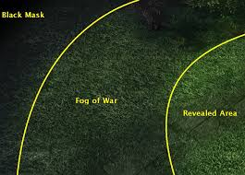
Fog of War
The revealed area is the union of all the sight ranges of all your units and buildings.
Previously viewed terrain and buildings within fog remain visible, but do not refresh state.
Never before viewed segments remains black until explored.

Slide 5
State of the Art
Yearly 1v1 AIIDE StarCraft AI competition between universities with competitors all over the globe.
Player skill ranked by iCCup2 ladder as E through A+
The best AI bots rank between D and D+
AI rely on a wide range of different techniques:
Some of the most effective have hard-coded “rush” strategies
Some rely on micro-managing unit control or deep learning
“Nova” uses a tiered system of base management and squad control with relatively simple unit AI
Partial observability is often ignored in favor of reacting to what can be seen at a given moment
Counter-strategies therefore rely on reacting to an enemy strategy rather than predicting it

Slide 6
Example Architectures

Slide 7
Novel Approach
Combine Probability Density Function (PDF) process with Tech Trees to create “strategy space” for possible enemy strategies
Use observations to strengthen nodes/edges in tree with multiplicative effect
Over time, the highest peaks will identify regions in “strategy space” where the enemy is most concentrated
While strategies are still being formed, Nova can act based on what region/quadrant has the largest average height

Slide 8
Tech Tree Representation
Edge weight increase with each unit spotted
Learned?

Slide 9
Strategy Templating
Strategies exist as templated subgraphs representing the unique paths taken in upgrade choices
“Vulture Rush”
“Marine Rush”
Notes:
AI profiles with unique weights based on observed habits

Slide 10
“Strategy Space”
16 Strategies identified by research as most common “build orders”
Lay out all strategies into a single supergraph and let the PDF additive process downselect to strategy leaf nodes for “localizing” on approach

Slide 11
“Strategy Space”
Ground Strategies
Aggressive Strategies
Defensive Strategies
Air Strategies

Slide 12
“Strategy Space Convergence”
As observations are laid on top of the strategy space, regions outside a “common strategy” will converge on which strategy is being used
This also allows early counter-strategies as observations result in the enemy trending into “aggressive”, “defensive”, “ground”, and “air” quadrants without waiting to see the full enemy strategy

Slide 13
Architecture
PDDL Reader
Capability
Status
PDDL File
Test Driver
StarCraft
Game Interface
(BWAPI)
Strategy Reader
Strategies
Inference Engine
Update Template Weights
Tree Builder

Slide 14
Who cares?
Intent recognition next step of autonomous operations as current planning systems reach high TRL
Partial observability is a reality of operational domains
Adversarial AI extends beyond physical into cyber
Benefits programs like AFRL STAT, DARPA Assured Autonomy, DARPA OFFSET… any program with potential for autonomy v autonomy OR where autonomy expected to reason without complete knowledge

Slide 15
Risks/Payoffs
Risk | Risk Mitigation
Strategies don’t map easily to quadrants | Place unusual strategies in region that results in “common” counter-strategy
Learning proves too time consuming due to length of games and number required for dataset | Professor (Dr. Santiago Ontañón) has render farm I can outsource to
Win rate does not improve | N/A – may require better learning to be more effective
Success would demonstrate the benefits of strategy inference in partial observability and provide a software “nugget” for winning adversarial AI programs

Slide 16
Measure of Success
Test Methods:
For each unit type, generate research trees and validate
For each building type, generate research trees and validate
For each upgrade type, generate research trees and validate
For each pair of unit and building, generate research trees and validate
Target Metrics:
100 Matches with and without inference engine (enemy team set to random)
Compare win/loss ratio of base NOVA and inference NOVA
NOVA already wins against standard AI at ~80-90%, so I don’t expect a significant improvement
May instead run against a suit of competition AI bots
Measure accuracy of predictions via Jaccard index (intersection over union)

Slide 17
Requirements
Blueforce – Player or Allied army
Redforce – hostile player
Capability - unit, building, or upgrade
Research – upgrades of unit or building capabilities purchased through an already built building
Strategy – A discrete collection of Capabilities in particular ratios designed to gain dominance over an opposing player with a bias towards land, hybrid, or air combat
ID | Requirement | Test Method
01 | The system shall represent the relationships and dependencies between units, buildings, and upgrades | Visual
02 | The system shall, given a Capability, determine what must be built or researched and what could be built or researched relative to other units, buildings, and upgrades | Automated
03 | The system shall, given a partial view of an enemy base, determine what must be built or researched and what could be built or researched relative to other units, buildings, and upgrades | Automated
04 | The system shall maintain a set of coarse strategies based on common play styles | Visual
05 | The system, given a representation of redforce Capabilities, suggest a strategy that the redforce is using | Automated
06 | The system shall, given multiple of a Capability detected, adjust the probability of each possible strategy | Automated
07 | The system shall, given ground truth and a predicted strategy, update the probabilities for the strategy based on Capability overlap | Automated

Slide 18
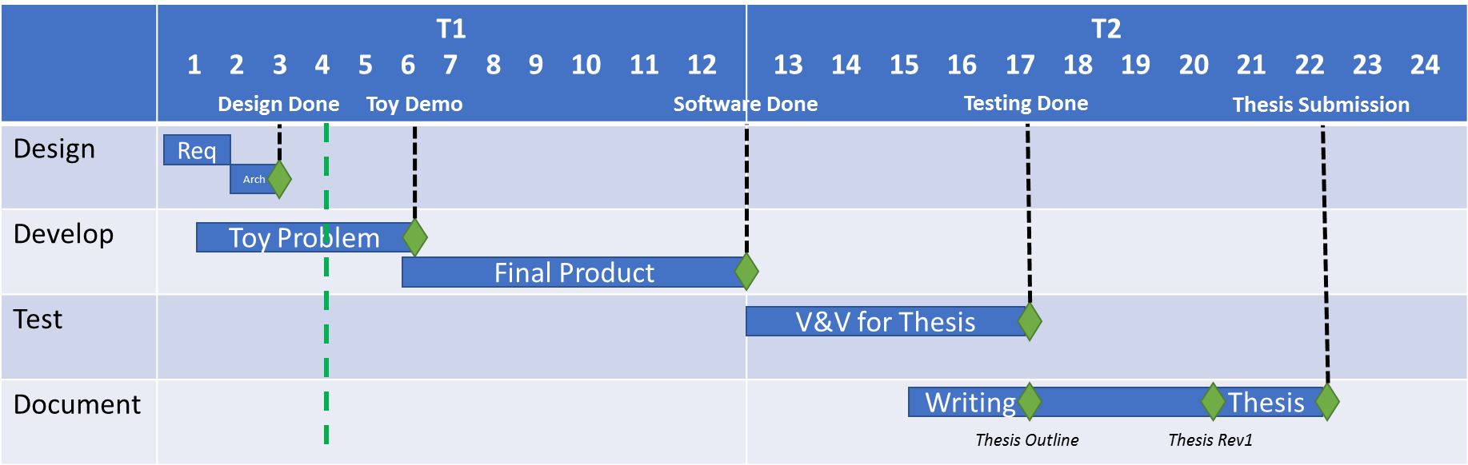
Schedule

Slide 19
Cost/Schedule
Task 1: Develop PDDL representation of all Starcraft assets
10 SMES Hours
Task 2: Combine PDDL representation and build orders to produce strategy trees
10 SMES Hours
Task 3: Take snapshot of final belief state and adjust strategy edge weights based on actual unit ratios
60 SMES Hours
Task 4: Perform automated testing of algorithm against 3 different types of competition AI
10 SMES Hours
Task 5: Generate Report/ Video Demo
10 SMES hours
Total 100 SMES Hours = $19.5k

